Slide 1
WE
RAG CASE STUDY · TELECOM EGYPT
An Intelligent Customer-Support
Chatbot for WE
A grounded, multilingual Retrieval-Augmented Generation assistant that answers customer questions from te.eg and uploaded documents.
Proof of Concept · Entertainment Services Module ·

Slide 2
WE
THE CHALLENGE
Thousands of customer questions, one overloaded support line
Telecom Egypt receives a constant stream of inquiries about services, plans, bills, and technical support — in Arabic, English, and Egyptian dialect. Customers expect fast, accurate, trustworthy answers.
1000s
•
Multilingual
of customer inquiries handled daily
Arabic, English, and Egyptian dialect must all be understood correctly.
•
Grounded answers
155
Every response must be bounded by official WE content — no invented prices or codes.
existing customer-service hotline the bot escalates to when it lacks an answer
•
Beyond the website
Customers should also be able to ask about their own uploaded documents.
2

Slide 3
WE
KNOWLEDGE BASE · SCRAPER.PY
Turning te.eg pages into clean, chunked text
1
2
3
4
Discover
Extract
Clean
Chunk
Follow every /w/ sub-service link from a category page (e.g. Entertainment).
Pull text from headings, paragraphs and list items; dedupe lines within each page.
Any line repeated across more than one page is nav/footer boilerplate — drop it.
Split into ~500-character, sentence-aware pieces; merge orphan trailing chunks.
Result so far: entertainment category fully scraped (call-tone, WATCH iT, WE Sports, play-and-win, number portability). Remaining categories are split across teammates.
5

Slide 4
WE
KNOWLEDGE BASE · VECTOR_STORE.PY
A persistent, multilingual vector store
•
Multilingual embeddings
paraphrase-multilingual-MiniLM-L12-v2 encodes Arabic and English chunks into the same vector space.
SAMPLE VECTOR RECORD
chunk_id
•
Cosine similarity
entertainment_call-tone_2
The collection is created with hnsw:space = cosine, matching how relevance is later scored.
url
te.eg/w/.../call-tone
•
Persistent, not in-memory
category
chromadb.PersistentClient writes to disk, so the knowledge base survives an app restart — required for on-prem deployment.
entertainment
source_type
Rich metadata per chunk
website
•
Each vector stores its url, category, and source_type (website vs. user_upload), enabling citation and filtered search.
embedding
[384-dim vector]
6

Slide 5
WE
DOCUMENT UPLOAD · DOCUMENT_LOADER.PY
Customers can also query their own documents
PDF
DOC
TXT
HTML
IMG
pypdf extracts text page by page
python-docx reads paragraphs and table cells
Read directly as plain text
BeautifulSoup pulls headings, paragraphs, list and table cells
Sent to Gemini's multimodal API to transcribe or describe — no local OCR install needed
Every uploaded file reuses the exact same chunk_page() logic as the scraper — so uploaded content is chunked consistently with scraped website content, then tagged source_type = "user_upload" so the RAG layer always knows where an answer came from.
7

Slide 6
WE
ANSWER GENERATION · RAG.PY
From a raw customer message to a grounded reply
1
2
3
4
Normalize
Retrieve
Filter
Generate
Gemini strips the message to its core WE topic, fixing typos and dropping irrelevant specifics (e.g. a singer's name).
The normalized query is embedded and matched against ChromaDB for the closest chunks.
Chunks with cosine distance above 0.55 are dropped — only genuinely relevant context reaches the model.
Gemini answers strictly from the surviving context, in the customer's own language, citing sources.
SYSTEM PROMPT GUARDRAILS
— Never invent prices, USSD codes, or details absent from context
— Escalate to 155 when the answer isn't in the knowledge base
— Reply in the same language the customer used
8

Slide 7
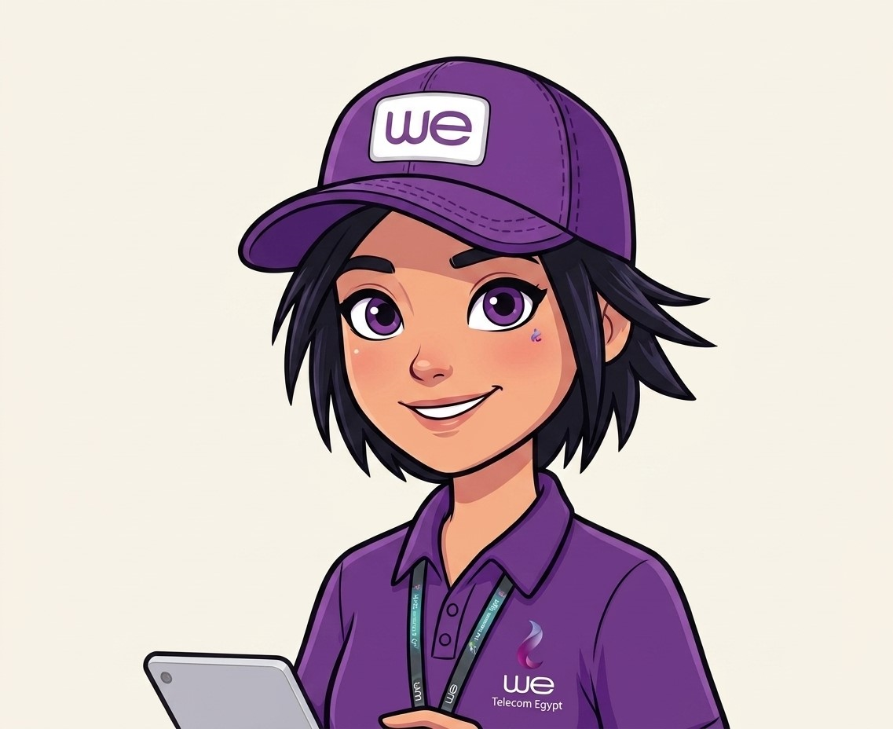

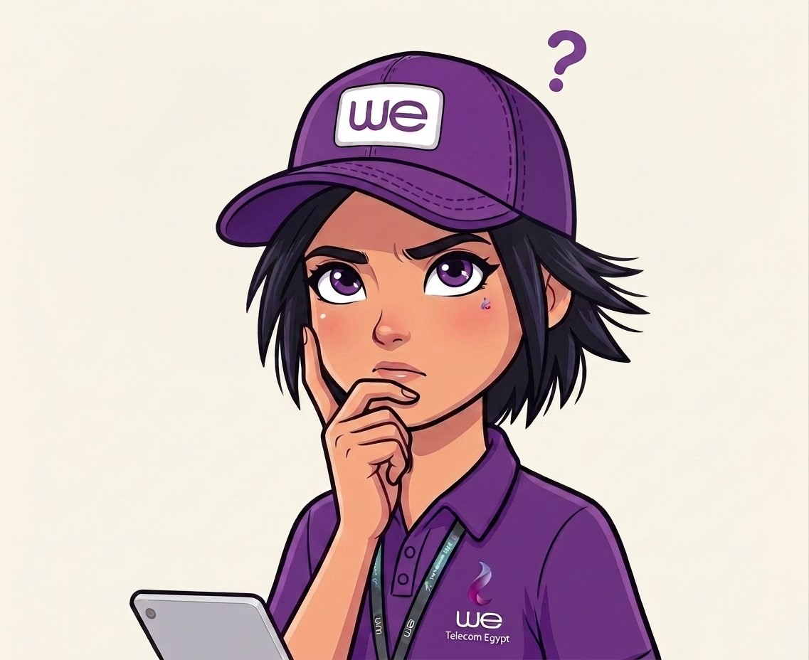

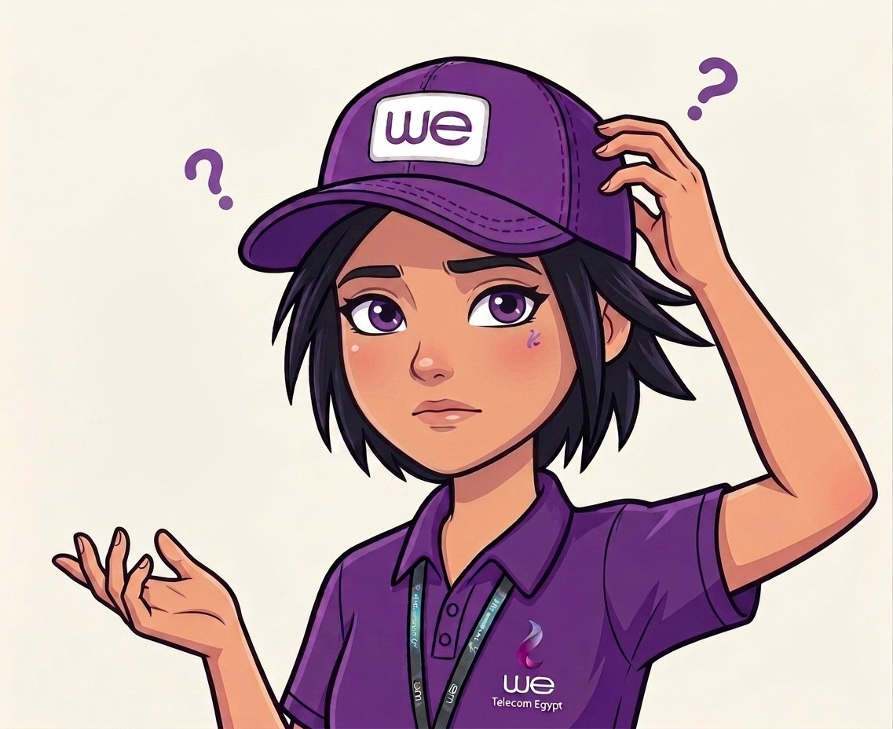
WE
INTERFACE · APP.PY
A branded, avatar-driven Gradio experience
Standalone Gradio app — no Colab dependency. Purple WE branding, centered avatar, RTL layout, and Arabic example prompts.
WE
1
Idle
Shown before any message and after a normal reply finishes
2
Thinking
Shown while waiting on Gemini's response
3
Talking
Reply is typed out on screen, character by character
4
Confused
Shown when the answer was a "don't have this info" fallback
Type….
9

Slide 8
WE
DEPLOYMENT
From prototype notebook to a deployable app
•
No notebook, no Colab lock-in
PROJECT STRUCTURE
app.py runs anywhere — local machine, VM, or Docker container.
scraper.py
te.eg scraping + chunking
•
Persistent knowledge base
Document_loader.py
multi-format upload handling
ChromaDB writes to disk under CHROMA_DB_DIR, so restarts don't lose the index.
vector_store.py
embeddings + ChromaDB
•
Config via environment
rag.py
retrieval + Gemini answers
python-dotenv loads GOOGLE_API_KEY from .env — never hard-coded.
ingest.py
one-shot / periodic KB build
•
Network-ready
app.py
standalone Gradio interface
Gradio launches on server_name 0.0.0.0, port 7860, for on-premises access.
10

Slide 9
WE
DEMO
Three kinds of questions, three grounded behaviors
SMALL TALK
COVERED QUESTION
UNCOVERED QUESTION
"hello"
عايز اعرف سعر الكول تون
عايز اعرف سعر خط الإنترنت
Responds naturally and briefly — no knowledge-base lookup needed.
Retrieves the matching entertainment chunk and answers with a source citation.
No relevant chunk clears the threshold — bot admits it doesn't know and points to 155.
11

Slide 10
WE
NEXT STEPS
From entertainment to the full WE catalog
1
Expand coverage
Add mobile, internet, landline, roaming, and portability categories as teammates finish scraping.
2
Harden retrieval
Tune the relevance threshold and chunk size against real customer queries.
3
Ship the deployment
Containerize app.py + ingest.py and schedule periodic re-ingestion as site content changes.
Thank you
Video : https://drive.google.com/drive/folders/128hLJIfhzlxcnfTX3yadMtPyVID_cQNe?dmr=1&ec=wgc-drive-%5Bmodule%5D-goto
12

